Slide 1
The Life of Stephen
Ordinary to Extraordinary
Acts 6: 8 – 7: 60

Slide 2
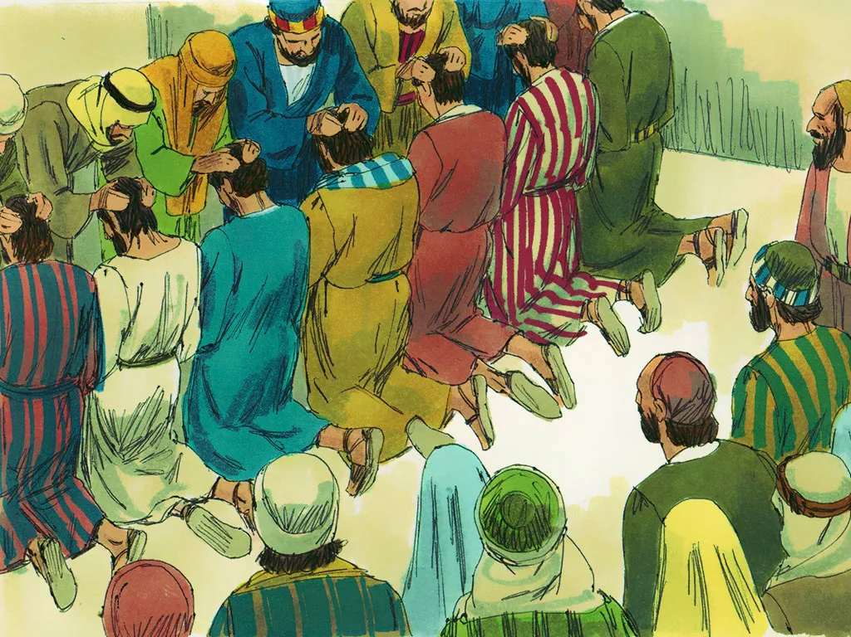
Called to Serve
One of the 7 Deacons chosen on Acts 6
Filled with the Holy Spirit
Filled with wisdom because of the Holy Spirit and his obedience

Slide 3
Opposition arose:
Note: anytime truth is spoken – opposition will arise!
Freedmen: Jews from N. Africa and Central Asia
Argued with Stephen and could not defeat him
Stephen spoke with wisdom the Holy Spirit gave him
Freedmen collected false witnesses against Stephen and took him to the Sanhedrin (Jewish Supreme Court)
The Sanhedrin looked at Stephen and saw his face was as bright as an angels…peace and confident

Slide 4
Chapter 7
The Sanhedrin asked, “Are these charges true?”
Stephen told the “big themes” of their Jewish history:
God’s Covenant with Abraham - 3 parts: 1) your decedents will be more than the stars in the sky; 2) the Promise Land; and 3) anyone who bless you (Jewish nation) God will bless and anyone who is against you – I (God) will be against
Isaac and Jacob

Slide 5
Jacob’s 12 sons: 10 older sons hated spoiled Joseph
Brings us to their family moved to Egypt (only 75 people then) to 400 yrs of captivity and more that 5 million Jews
Enters Moses at 80 years old called to return to Egypt
Crossing of the Red Sea…the people still worshipped false gods – Molech (sun god, brass, heated and babies were place in it’s arms to burn to death) and Rephan (Saturn, the god of evil influence - rebellion).
While still in the dessert, God gave the 10 Commandments and the Tabernacle (“the Tent” of worship)

Slide 6
Then Joshua was used to conquer and bring them into the Promise Land
Then David to Solomon who built the Temple and God asks, “Do you think I live in houses made by human hands?”
Boom! The transition and application:
Today – you are still the SAME! You are:
Stiff necked (stubborn); Always persecuting His prophets; you killed the Righteous One (Jesus); and you have the Laws of God but you still do not obey them…

Slide 7
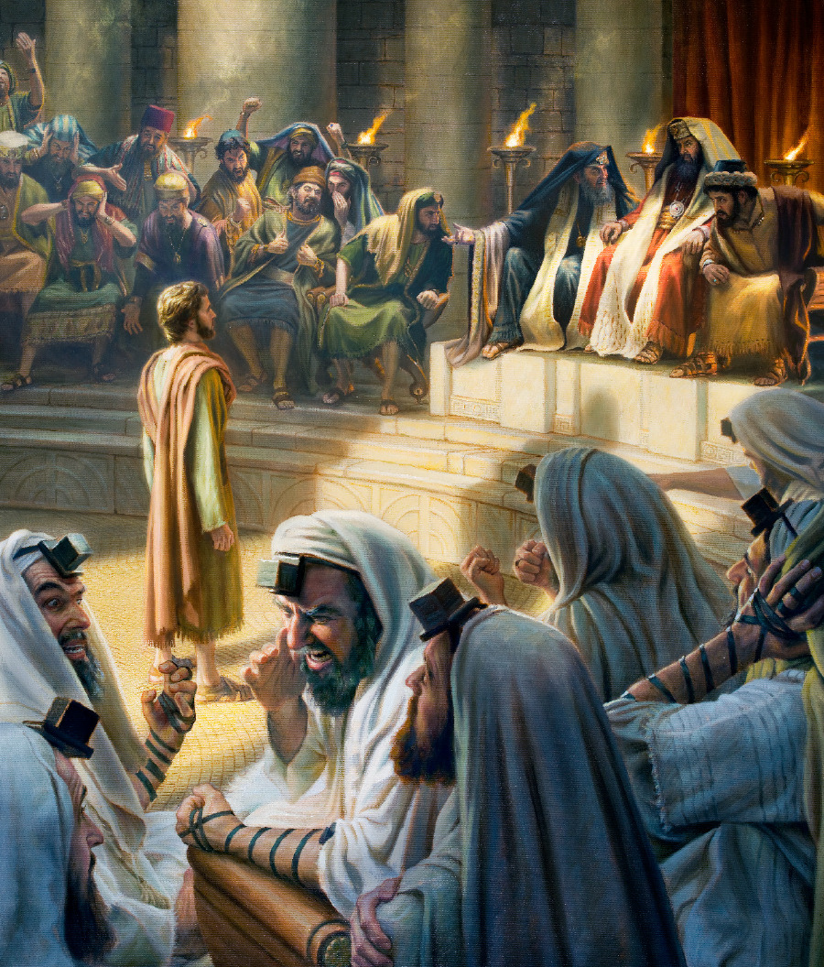
The Sanhedrin covered their ears, yelling and gnashing their teeth, rushed at Stephen and dragged him out of the Temple
As they left the Temple, the witnesses threw their coats at Saul’s feet (Paul)
Stephen’s last words, “Lord Jesus, receive my spirit…” and “Lord, do not hold this sin against them…”
And Stephen died…

Slide 8
What do we see…
The Freedmen, Sanhedrin & Saul
Stephen & many others after him
Heard & by faith believed – just ordinary
Understood Jesus is REAL
Lived obediently – whatever the cost…
Those who knew the “stories”
Nice and religious
Not for me…

Slide 9
Which are you?

