Slide 1
The ‘Outside the box’ God
Acts 10: 1 - 48

Slide 2
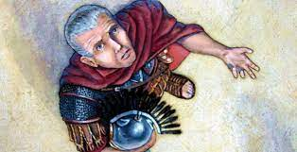
Meet Cornelius – Acts 10: 1- 8
Caesarea: the town where the Roman governor of all of Judea lived
Centurion: Captain of 100 men – possibly guarding the Governor – Italian Regiment
He and all his family were devout worshippers of God, prayed constantly, and gave to the poor
An angel spoke to him…

Slide 3
V4 “Your prayers and gifts to the poor have come up as a memorial offering to God”…
Memorial Offering: Leviticus 2:2, “The priest would take a handful of the flour and oil, together with all the frankincense, and burn this as a memorial portion on the altar, an offering made by fire, a pleasing aroma to the Lord.”
“a pleasing sweet and soothing offering…”

Slide 4
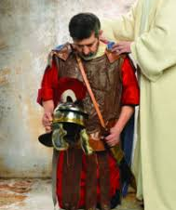
Vv 5 & 6 The angel told Cornelius to send for Peter – Peter was still in Joppa (Isaiah 66, “I will bless the humble and contrite heart…”)
Immediately after the angel left, Cornelius sent 2 of his attendants who were also devout soldiers
Cornelius told them everything that happened and sent them to Joppa to bring Peter to Caesarea

Slide 5
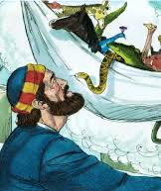
God prepares Peter – vv9 - 23
In Joppa, noon time, Peter was praying on the roof – hungry – a vision of a sheet coming down from heaven and the Lord said, “Get up, Peter. Kill and eat.”
Peter responds, “I have never eaten unclean things like these…”
God responded, “Do not call anything impure that I have made clean”… happened 3X, then the sheet was taken away…Peter wondered, ‘???’

Slide 6
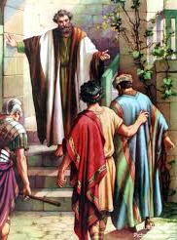
God’s directions becoming clearer:
The men sent by Cornelius were waiting at Simon the tanner’s house gate
The Spirit told Peter not to hesitate – but go with them
They explained to Peter why they were there.
Peter invited them to stay the night then they went to Caesarea

Slide 7
God breaks the expected tradition
In Caesarea, Peter enters Cornelius’ home “You know this is against our Jewish Laws…but God…” Peter asks, “Why am I here?”
Cornelius tells Peter about his conversation with the angel and says, “Now we are all here in the presence of God to listen to everything the Lord has commanded you to tell us.”

Slide 8
As Peter is preaching…
Peter explains God’s plan – Jesus, the Son of God, Who gave His life to forgive us of our sins, Jesus died and rose again – we saw Him after He was buried and resurrected…
While Peter was still speaking, the Holy Spirit fell upon all who heard the message … and they worshiped Christ and spoke in tongues and praised Him

Slide 9
Now what are we going to do???

Slide 10
And Peter responded:
“Surely no one can stand in the way of their being baptized with water. They have received the Holy Spirit just as we have.”
So Peter ordered that they be baptized in the name of Jesus Christ. Then they asked Peter to stay with them a few days.

Slide 11
What do we see?
God will bless the contrite (humble & hungry) heart who seeks Him
Peter was unwilling – yet yielded and served
God breaks the expected “norm”/tradition
Who in our community has been labeled “unclean” (no good)?
Who is God sending us to?

